Slide 1

MIT School of Computing
Department of Computer Science & Engineering
Third Year Engineering
23CSE3011 - Design and Analysis of Algorithms
Class - T.Y. (SEM-V)
Unit - V
Storage Management
AY 2026-2027 SEM-V

Slide 2

Dept. of Computer Science & Engineering.
UNIT - V SYLLABUS
NP-hard and NP-Complete Problems: Basic concepts, deterministic and non-deterministic algorithms, NP-hard and NP-complete classes, Cook‘s theorem;
Approximation Algorithms for the NP-Hard Traveling Salesman Problem: Nearest-neighbour algorithm, Twice-around-the-tree algorithm.

Slide 3
Dept. of Computer Science & Engineering.
Introduction
We saw in previous units, There are problems that are difficult to solve algorithmically.
At the same time, some of them are so important that we cannot just sigh in resignation and do nothing.
This unit outlines several ways of dealing with such difficult problems.
The other distinction between backtracking and branch-and-bound lies in the order in which nodes of the state-space tree are generated.
For backtracking, this tree is usually developed
depth-first (i.e., similar to DFS).
Branch-and-bound can generate nodes according to several rules: the most natural one is the so-called best-first rule explained

Slide 4
Dept. of Computer Science & Engineering.
Introduction to Backtracking
The principal idea is to construct solutions one component at a time and evaluate such partially constructed candidates as follows.
If a partially constructed solution can be developed further without violating the problem’s constraints, it is done by taking the first remaining legitimate option for the next component.
If there is no legitimate option for the next component, no alternatives for any remaining component need to be considered.
In this case, the algorithm backtracks to replace the last
component of the partially constructed solution with its next option.

Slide 5
Dept. of Computer Science & Engineering.
Introduction to Backtracking
It is convenient to implement this kind of processing by constructing a tree of choices being made, called the state-space tree.
Its root represents an initial state before the search for a solution begins.
The nodes of the first level in the tree represent the choices made for the first component of a solution, the nodes of the second level represent the choices for the second component, and so
on.
A node in a state-space tree is said to be promising if it corresponds to a partially constructed solution that may still lead to a complete solution; otherwise it is called nonpromising

Slide 6
Dept. of Computer Science & Engineering.
NP Class Problems
NP class problems are hard to implement
Easy to verify
Exponential in nature
Are verified in polynomial time
Non-tractable problems
Security problems are of type NP

Slide 7
Dept. of Computer Science & Engineering.
n-Queens Problem
“In backtracking, for n queen problem it should be pointed out that a single solution to the n-queens problem for any n ≥ 4 can be found in linear time ”

Slide 8
Dept. of Computer Science & Engineering.
P-Class Problems
P class problems are easy to implement
Easy to verify
Polynomial in nature
Tractable problems

Slide 9
Dept. of Computer Science & Engineering.
Reduction
Let A and B are two problems then problem A reduces to problem B iff there is a way to solve A by deterministic algorithm that solves B in polynomial time.
If A is reducible to B then A ∝ B.
If A is reducible to B and B in P then A in P.
If A not in P implies B not in P.
A
B

Slide 10
Dept. of Computer Science & Engineering.
NP Hard
A problem is NP hard if every problem in NP can be polynomial reduced to it.
Basically NP hard are optimization problems.
P
NP
NP Hard
P

Slide 11
Dept. of Computer Science & Engineering.
NP Complete
A problem is called NP complete if it is in NP and it is NP-Hard.
The intersection of NP and NP hard is NP complete problem.
Basically NP complete are decision problems.
Example: If problem A is a Decision problem and problem B is Optimization problem then it is possible A ∝ B.
Example : Knapsack decision problem can be converted into knapsack optimization problem.
All NP-Complete problems are NP-Hard but all NP-Hard problems are not NP-Complete.
NP

Slide 12
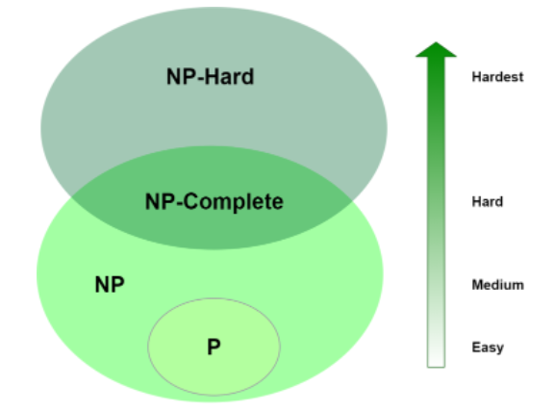
Dept. of Computer Science & Engineering.
NP Complete
NP

Slide 13
Dept. of Computer Science & Engineering.
Summary
Computational complexity -
  Polynomial(P)
  Non deterministic polynomial(NP-Class)
    NP- Hard
    NP-Complete

Slide 14
Dept. of Computer Science & Engineering.
Approximation Algorithms
An algorithm that uses random numbers to decide what to do next anywhere in its logic (at least once)is called Randomized Algorithm.
For example, in Randomized Quick Sort, we use random number to pick the next pivot
Of course, if we use an algorithm whose output is just an approximation of the actual optimal solution, we would like to know how accurate this approximation
is.
We can quantify the accuracy of an approximate solution sa to a problem of minimizing some function f by the size of the relative error of this approximation
Properties of approximation algorithms are
Guaranteed to run in polynomial time
Guaranteed to get a solution which is close to the optimal solution (near optimal

Slide 15
Dept. of Computer Science & Engineering.
Approximation Algorithms
An algorithm that uses random numbers to decide what to do next anywhere in its logic (at least once)is called Randomized Algorithm.
For example, in Randomized Quick Sort, we use random number to pick the next pivot
Of course, if we use an algorithm whose output is just an approximation of the actual optimal solution, we would like to know how accurate this approximation
is.
We can quantify the accuracy of an approximate solution sa to a problem of minimizing some function f by the size of the relative error of this approximation
Properties of approximation algorithms are
Guaranteed to run in polynomial time
Guaranteed to get a solution which is close to the optimal solution (near optimal

Slide 16
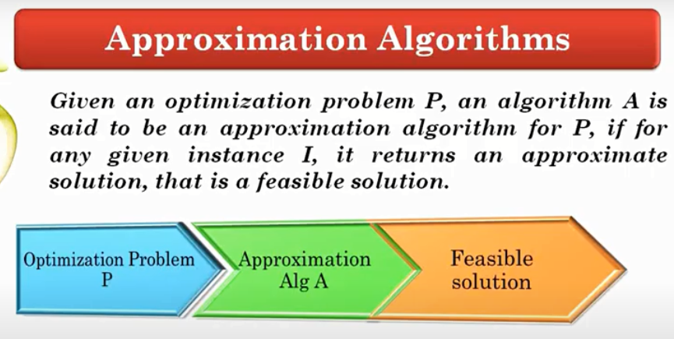
Dept. of Computer Science & Engineering.
Approximation Algorithms

Slide 17
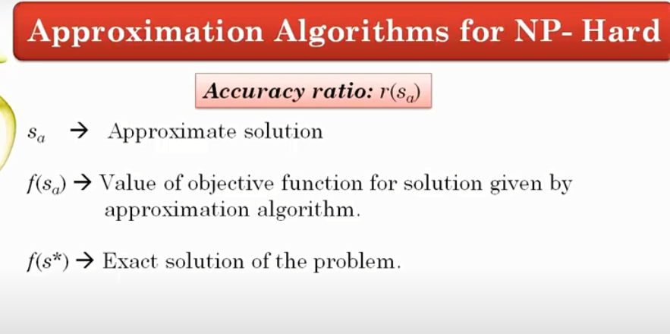
Dept. of Computer Science & Engineering.
Approximation Algorithms

Slide 18
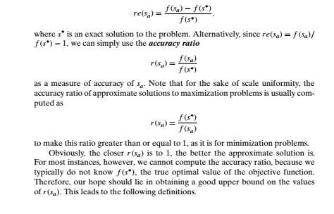
Dept. of Computer Science & Engineering.
Approximation Algorithms

Slide 19
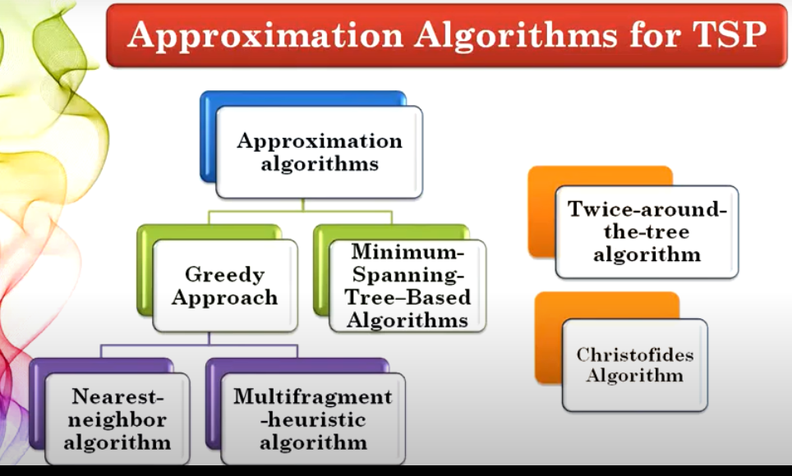
Dept. of Computer Science & Engineering.
Approximation Algorithms

Slide 20
Dept. of Computer Science & Engineering.
Nearest-neighbor algorithm for TSP
The following well-known greedy algorithm is based on the nearest-neighbor
Heuristic: always go next to the nearest unvisited city.
Step 1 Choose an arbitrary city as the start.
Step 2 Repeat the following operation until all the cities have been visited:
go to the unvisited city nearest the one visited last (ties can be broken arbitrarily).
Step 3 Return to the starting city.

Slide 21
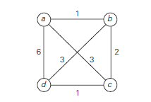
Dept. of Computer Science & Engineering.
Nearest-neighbor algorithm for TSP
Example:
Apply nearest-neighbour algorithm for the instance of TSP represented by graph given below. Also find accuracy ratio for the same.

Slide 22
Dept. of Computer Science & Engineering.
Nearest-neighbor algorithm for TSP
Solution :
Now we will apply exhaustive search. That is, we will find all
possible tours from node a.
Tour | Length
a – b-c-d- a | 10
a - b-d-c- a | 8
a - c-b-d- a | 14
a – c-d-b- a | 8
a –d-b-c- a | 14
a – d-c-b –a | 10

Slide 23

Dept. of Computer Science & Engineering.
Nearest-neighbor algorithm for TSP
Solution :
The optimal solution, as can be easily checked by exhaustive search, is the tour
s∗: a − b − d − c − a of length 8.
Thus, the accuracy ratio of this approximation is

Slide 24
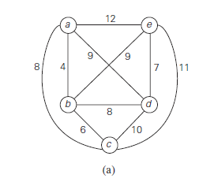
Dept. of Computer Science & Engineering.
Nearest-neighbor algorithm for TSP
Example: Apply twice around the tree algorithm on the graph given below -

Slide 25
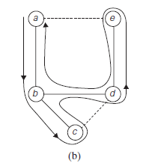
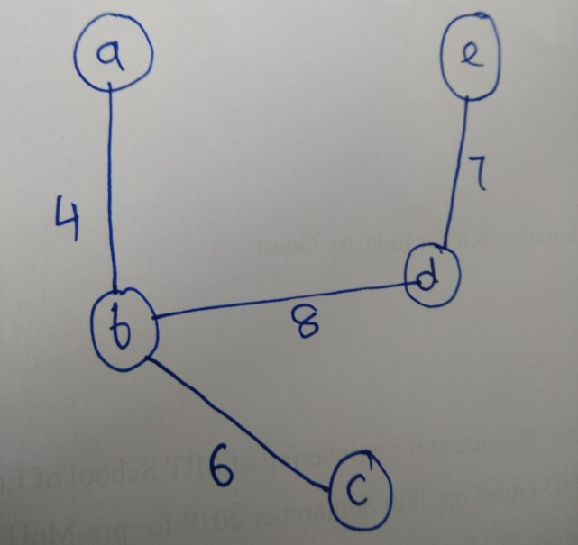
Dept. of Computer Science & Engineering.
Nearest-neighbor algorithm for TSP
Solution: A twice-around-the-tree walk that starts and ends at a is
a, b, c, b, d, e, d, b, a.
Eliminating repetitions yields the
Hamiltonian circuit
a, b, c, d, e, a of length 39.

Slide 26
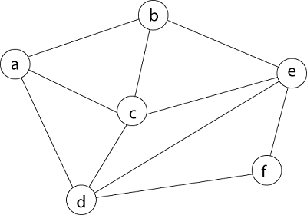
Dept. of Computer Science & Engineering.
Hamilton Circuit Problem
A Hamiltonian cycle is a cycle that contains all vertices in a graph exactly once.
Example: Possible Hamilton cycle for the graph: a-b-c-e-f-d-a

Slide 27
Dept. of Computer Science & Engineering.
Hamilton Circuit Problem
Given a graph G = (V, E) we have to find the Hamiltonian Circuit using Backtracking approach.
We can assume that if a Hamiltonian circuit exists, it starts at vertex a. Accordingly, we make vertex a the root of the state-space tree .
The first component of our future solution, if it exists, is a first intermediate vertex of a Hamiltonian circuit to be constructed.
Using the alphabet order to break the three-way tie among the vertices adjacent to a, we select vertex b. From b, the algorithm proceeds to c, then to d, then to e, and finally to f, which proves to be a dead end.

Slide 28
Dept. of Computer Science & Engineering.
Hamilton Circuit Problem
So the algorithm backtracks from f to e, then to d, and then to c, which provides the first alternative for the algorithm to pursue.
Going from c to e eventually proves useless, and the algorithm has to
backtrack from e to c and then to b.
From there, it goes to the vertices f , e, c, and d, from which it can legitimately return to a, yielding the Hamiltonian circuit a, b, f , e, c, d, a.
If we wanted to find another Hamiltonian circuit, we could continue this process by backtracking from the leaf of the solution found.

Slide 29
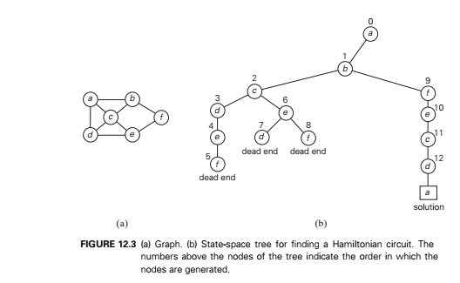
Dept. of Computer Science & Engineering.
Hamilton Circuit Problem

Slide 30
Dept. of Computer Science & Engineering.
Hamilton Circuit Problem
If we wanted to find another Hamiltonian circuit, we could continue this process by backtracking from the leaf of the solution found.

Slide 31
Dept. of Computer Science & Engineering.
Thank You

